Slide 1
LL1 parser table
1
Presented By : Team Zero
Our team members are
Nabil-01
Adib-02
Ava-03
Akram-04
MD Rayhan -05
Date: 03/08/2025

Slide 2
2
Grammar:
S → LM
L → l | ε
M → mN
N → n | ε
Construct the parse table for the LL(1) grammar and parse the input string lmn$
It is not ambiguous, left recursive, non-deterministic. So no need to eliminate ambiguity, left recursion or non-determinism. We have used some blue boxes ( ) here for the audience’s better understanding.

Slide 3
FIRST And FOLLOW Sets
3
STRING | FIRST | FOLLOW
S
L
M
N
Grammar:
S → LM
L → l | ε
M → m N
N → n | ε
{l, m}
{$}
{l, ε}
{m, $}
{m}
{$}
{n, ε}
{$}

Slide 4
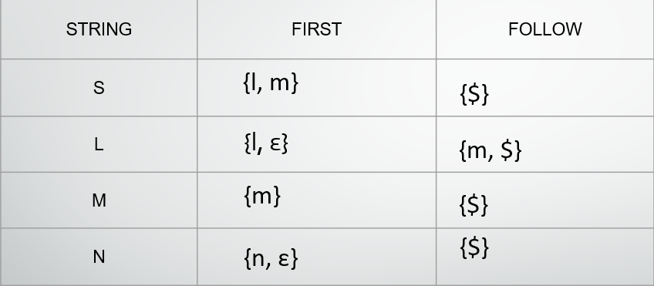
LL(1) Parser Table:
4
Non-Terminal | l | m | n | $
S | S → LM | S → LM
L | L → l | L → ε |  | L → ε
M |  | M → mN
N |  |  | N → n | N → ε
FIRST and FOLLOW Sets

Slide 5
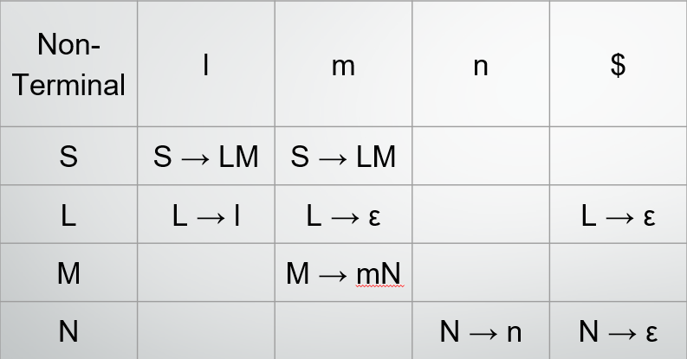
LL(1) Stack Implementation:
5
Step | Stack | Input | Output
1 | S$ | lmn$ | S → LM
2 | M L $ | lmn$ | L → l
3 | M l $ | lmn$ | pop
4 | M $ | mn$ | M → mN
5 | N m $ | mn$ | pop
6 | N $ | n$ | N → n
7 | n$ | n$ | POP
8 | $ | $ | ACCEPTED
LL(1) Parser Table:

Slide 6
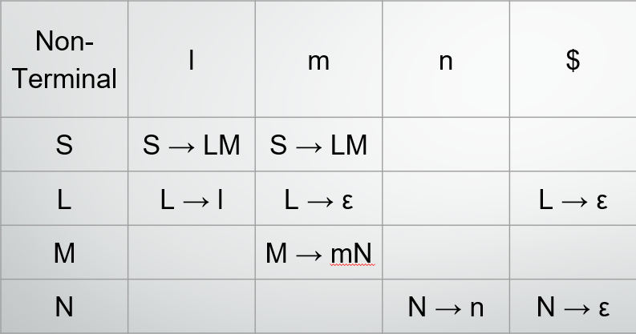
6
Parse Tree:
LL(1) Parser Table:
S
L
M
l
N
ε
m
n
ε

Slide 7
7
Conclusion:
The given grammar is LL(1) as its parse table has no conflicts (each cell has at most one production). Using the FIRST and FOLLOW sets, we successfully built the parse table and simulated the input lmn$ using LL(1) stack parsing, which ended in acceptance. This confirms that the string “lmn” is part of the language defined by the grammar. The corresponding parse tree follows the derivation S → LM → l m n, clearly showing how the input is generated by the grammar.

Slide 8
8
Thank You!
💬 For queries or more insights, feel free to ask!

